Slide 1
IBM Data Science Capstone Project: Data Analysis Issues in Complex Systems - Crime Data
Ben Williams

Slide 2
Introduction and Background
The role of a data scientist is to analyse and evaluate datasets in order to investigate, supporting evidence for or provide new insights into a particular topic either within a research setting or within a real-world application scenario. Here, I provided a very brief overview of how although data science provides an extra set of tools in the arsenal of data analysis methods available to researchers, there are limitations of any analysis toolkit in very complex systems.
In this particular scenario I used the quantifiable prediction of crime as an example of a complex system where some predictive insights can be drawn from data, but due to the complexity of inputs that cause crimes and the limited amount of data available, producing a quantifiable predictive tool for crime on a large scale is challenging.

Slide 3
Introduction and Background
The main topics considered within this report are:
Crime in relation to weather. Pleasant hotter weather may lead to increases of certain crime types such as anti-social behaviour as many people are out of their homes leading to larger numbers of interactions with other people they would not normally interact with in hot weather.
Crime in relation to local events. As above, local popular events lead to large numbers of people interacting, potentially affecting certain crime types.
Crime over time. Changes in policing policy may be reflected within large dataset.
Crime due to proximity to 'Public Houses' (pubs). Although alcohol is a well known cause of antisocial crime, whether the location of local pubs is an influence to location of certain crime types is briefly investigated.
Predicting crime based on local area codes. The dataset is assessed for any possibility of predicting crime types over a short defined time period based on local area.
I believe this topic would be of interest to anyone in the field of data science who is keen to apply data analysis methods in real world scenarios but also is interested in finding where the limits of data science are when either insufficient datasets or analysis methods are available.

Slide 4
Data Source Types and Use
I took and analysed data from the following sources and in the manner described below:
All available non-archived crime data available in the Gloucestershire area of the UK at the time of writing (https://data.police.uk/data/). From here I created several data frames with normalised and non-normalised data of crime types and crime outcomes per location over a 3 year time period by month and converted categorical data to numerical data for later analysis. Crimes that contained no data on latitude and longitude were discounted from the study, but missing data of crime types or outcome were still included.
Average UK temperature data over the same time period as the crime data (https://www.metoffice.gov.uk/research/climate/maps-and-data/uk-climate-averages). Due to the small size of the data set the data was manually entered into several list() variables that were then used to create a dataframe. This data was then overlayed against normalised data of total crimes in the local area over time.
API calls from FourSquare.com (https://foursquare.com/developers/apps) for (pubs) that sell alcohol within a town of interest called Cheltenham Spa were overlaid on a map and visually compared to a dot plot map of crimes that were assumed could potentially be linked to increased alcohol consumption in a local area over a defined time period.
In terms of data exploration and evaluation, various maps, bar chart, line graph, waffle chart, K nearest neighbours (KNN) and Principle Component Analysis (PCA) methods were used as visualisation and analysis tools of the above data. For KNN evaluation, sklearn metrics .accuracy_score() was used.

Slide 5
Method
A bar chart (Image 1) was created to give a basic overview of total crimes by year month by month to look for any trends or patterns. A line graph of average UK temperatures was also created to view for a general pattern that matched the crime figures (Image 2)
As a potential pattern was observed the total crimes and temperature data was normalised and plotted together (Image 3), indicating that there is a general pattern observed of total crime vs average UK temperature but there is also a noticable difference in 2017, particularly March (further discussed in following sections)
A brief assessment from print statements on the dataframes suggested that the type of crime may also be a contributing factor to the higher total crimes in particular months (Image 4)

Slide 6
Method
A dictionary was then created out of the highest crime month to date and this was then used to plot a waffle chart (Image 5) of the associated crimes for the date March 2017 (appropriate libraries are also shown/re-imported for this feature so that the data could be looked at separately in another workbook separate to the intial line and bar charts)
An initial cluster map (Image 6) for visualisation was created to look at the data per location within the time frame mentioned
Partly due to long-processing time or failed visualisations, the map was altered to just dot plots (Image 7) for a less visually impressive but easily to work with map

Slide 7
Method
For the API call via FourSquare for pubs the appropriate libraries were imported or re-imported (for reasoning mentioned before) and the category extracted from the results of the call. The results were plotted onto a map (Image 8) for a basic visual comparison to the data points from Cheltenham_map2 with Red signifying the located town centre and blue dots for the pubs identified from the API call (Foursquare ID and secret not shown for privacy purposes)
The data was then processed changing categorical data into numeric data. Data was then pre-processed for KNN assessment. KNN was used as it is an unsupervised learning technique that is effective in clustering data into groups that may have a relationship between them. This categoriesed data can then be used to assess if a prediction can be made on the test set compared to the training set. Multiple K were plotted against predictive accuracy score comparing the crime type vs available data (Image 9). Categorical data was also dropped prior to PCA assessment
Appropriate libraries were imported for PCA assessment of the last outcome of the crime vs location of crime committed. PCA was used to make an assessment of whether assuming that location of crime committed is one of the largest contributing factors, whether there is any obvious trend displayed or not for the outcome type (Image 10)

Slide 8
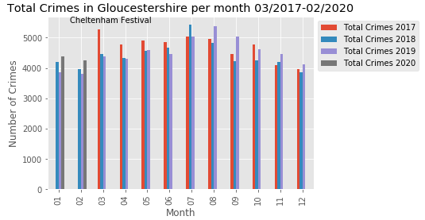
Results image 1

Slide 9
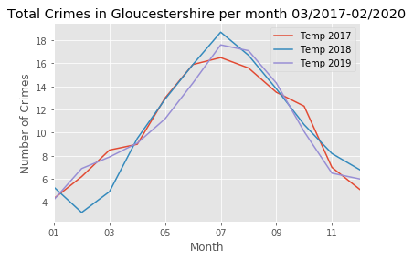
Results image 2

Slide 10
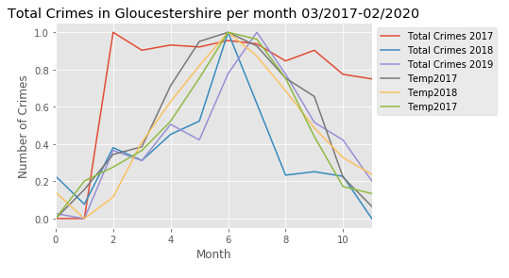
Results image 3

Slide 11
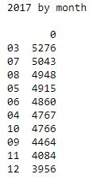
Results image 4

Slide 12
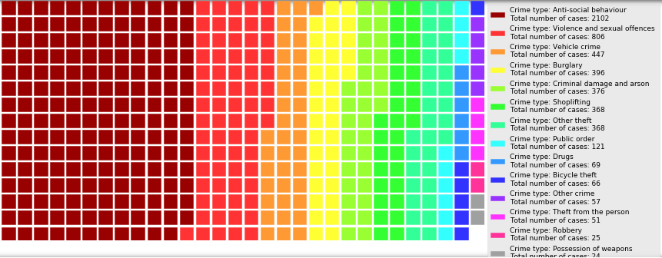
Results image 5

Slide 13
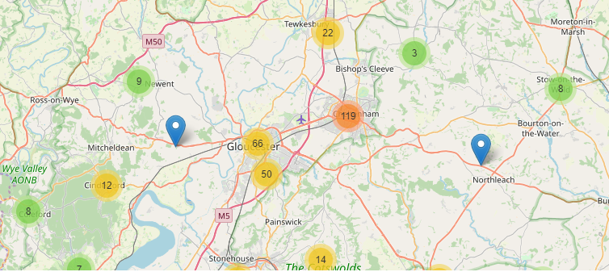
Results image 6

Slide 14
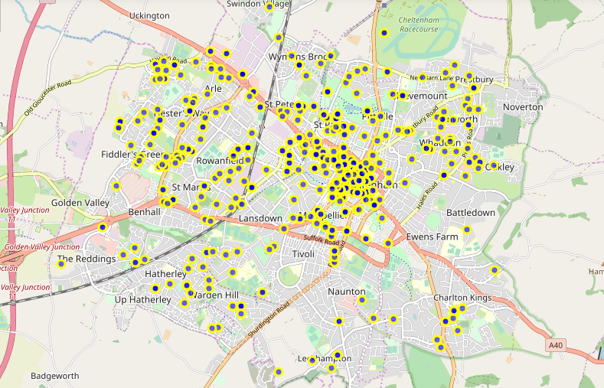
Results image 7

Slide 15
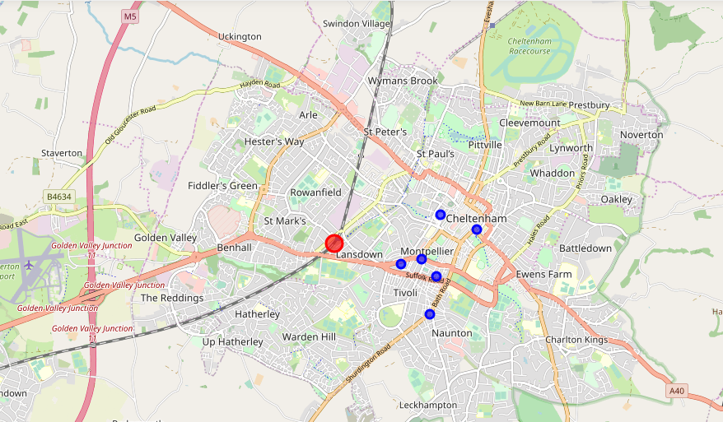
Results image 8

Slide 16
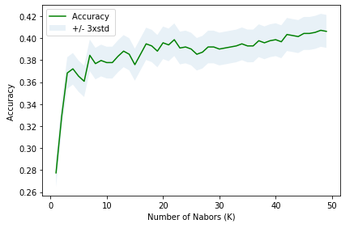
Results image 9

Slide 17
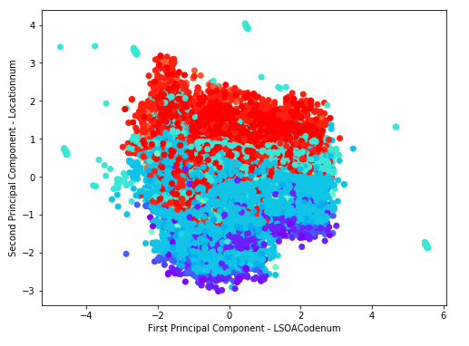
Results image 10

Slide 18
Discussion
For full discussion see final full report.

Slide 19
Conclusion
There may be many reasons for the variation seen in the data not covered in this short report and many other variables not considered in this dataset. As this was only an introductory report to the topic of uses and limitations of machine learning in complex systems there are only a fewe take home conclusions:
Local events, weather, proximity to town centre and specific time points throughout the year all contribute to varying levels of crime.
Data visualisation is an excellent tool for demonstrating these general insights.
Machine learning can help identify trends in complex systems but the algorithms used here were not sufficiently sophisticated and the number of variables for the data too few in order to create a high level predictive tool for crime type by location.
Further work and research into this area would be fascinating!

